Slide 1
Module 2 – Functions, Strings, Objects – Part 2
Chapters 3 and 8

Slide 2
Objects and Strings

Slide 3
The str Class
Creating Strings
s1 = str() # Create an empty string
s2 = str("Welcome") # Create a string Welcome
Python provides a simple syntax for creating string using a string literal. For example,
s1 = "" # Same as s1 = str()
s2 = "Welcome" # Same as s2 = str("Welcome")

Slide 4
Introduction to Objects and Methods
In Python, all data—including numbers and strings—are actually objects.
Object
is an entity
each object has an id and a type
objects of the same kind have the same type
can use the id function and type function to get these information for an object

Slide 5
Object Types and Ids
id and type functions are rarely used, but are helpful for understanding objects.
>>> n = 3 # n is an integer
>>> id(n)
505408904
>>> type(n)
<class ’int’>
>>> f = 3.0 # f is a float
>>> id(f)
>>> 26647120
>>> type(f)
<class ’float’>
>>> s = "Welcome" # s is a string
>>> id(s)
36201472
>>> type(s)
<class ’str’>

Slide 6
Variables and Objects
variables n, f, and s are references to the actual objects - an int object, a float object, and a str object. The variables point to these objects.

Slide 7
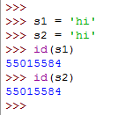

Variables and Objects (str)
Sometimes two different variables can be pointing at the same object:
a string object
id:
value:
This object is an instance of the str class
String objects are immutable; once created, contents cannot be changed. To optimize performance, Python uses a single object for strings with the same contents.

Slide 8
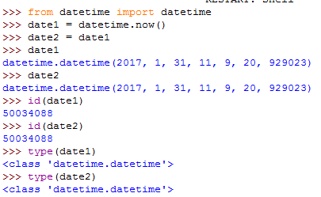
Variables and Objects (datetime)
Sometimes two different variables can be pointing at the same object:
a datetime object
id:
year:
2017
month:
1
This object is an instance of the datetime class
day:
31
hour:
11
minute:
9
second:
20
microsecond:
929023
https://docs.python.org/2/library/datetime.html

Slide 9
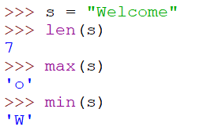
String functions
len() returns the number of characters in the string
max() returns the character with the highest value (ASCII)
min() returns the character with the lowest value

Slide 10

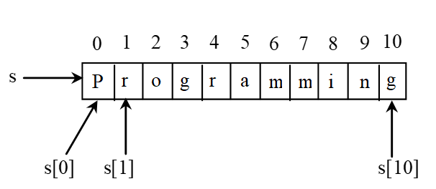



String functions - Index

Slide 11
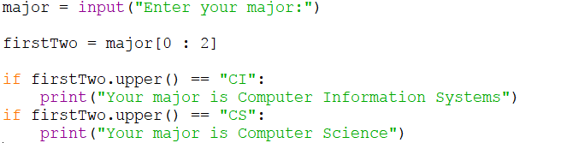
Simple If Demo

